Slide 1
Mind Your Language
Quick sentence analysis using Natural Language Processing
Ankur Sharma
ankurs@ .com

Slide 2
Intelligence
intelligence
ɪnˈtɛlɪdʒ(ə)ns
noun
capacity for learning, reasoning, understanding, and similar forms of mental activity; aptitude in grasping truths, relationships, facts, meanings, etc.
manifestation of a high mental capacity

Slide 3
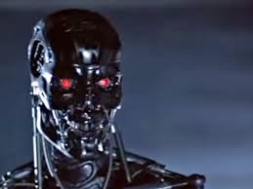

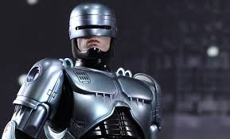
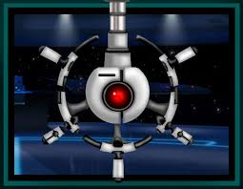
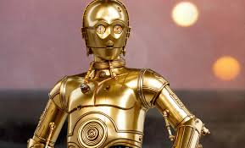
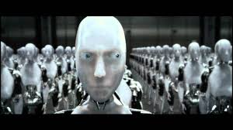
Artificial Intelligence

Slide 4
AI today
Optical Character Recognition
Dominoes, Sudoku
Textual Search
Navigation
Face Detection
Handwriting Recognition
Go, Poker
Image Search
Autonomous Vehicles
Face Recognition
Patterns
Strategy
Classification
Training
Learning

Slide 5
Natural Language Processing
Is it AI?
What is Natural Language?
NLP
Linguistics – Grammar, Phonetics, Scripts
Words, Phrases, Sentences
Parts of Speech
Classification

Slide 6
Apache OpenNLP
Language Detection
Sentence Detection
Tokenizer
Name Finder
Document Categorizer
POS Tagger
Lemmatizer
Chunker
Parser

Slide 7
Tokenization
Word Detection
Subject: John Connor.
Mother: Sarah J. Connor.
Legal Guardians: Todd and Janelle Voight.
523 S. Almond. Reseda, CA.
I wud like 2 order….ummm…..3large pizza &a coke
Book a cab for 7/29 about 4:00pm

Slide 8
Tokenization
Where used?
Hyphenation
Contraction
DSL
N-grams
Translations
Genetics

Slide 9
Classification
Document categorization
Classify text into one of the pre-determined category

Slide 10
Classification
Demo

Slide 11
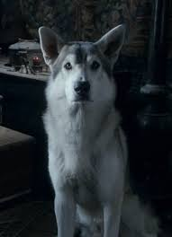
First Words
Sit
Quite
Run
Fetch
Go

Slide 12
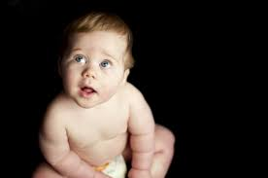
First Words
Papa
Ma
Dada
Akka

Slide 13
Parts of Speech
Noun
Pronoun
Verb
Adjective
Adverb
Conjunction
Preposition
Interjection

Slide 14
POS Tags
CC Coordinating conjunction
CD Cardinal number
DT Determiner
EX Existential there
FW Foreign word
IN Preposition
JJ Adjective
JJR Adjective, comparative
JJS Adjective, superlative
LS List item marker
MD Modal
NN Noun, singular or mass
NNS Noun, plural
NNP Proper noun, singular
NNPS Proper noun, plural
PDT Predeterminer
POS Possessive ending
PRP Personal pronoun
PRP$ Possessive pronoun
RB Adverb
RBR Adverb, comparative
RBS Adverb, superlative
RP Particle
SYM Symbol
TO to
UH Interjection
VB Verb, base form
VBD Verb, past tense
VBG Verb, gerund or present participle
VBN Verb, past participle
VBP Verb, non-3rd person singular present
VBZ Verb, 3rd person singular present
WDT Wh-determiner
WP Wh-pronoun
WP$ Possessive wh-pronoun
WRB Wh-adverb

Slide 15
POS
Demo

Slide 16
Reads
Apache OpenNLP
https://opennlp.apache.org
Book
http://www.nltk.org/book/
Models
http://opennlp.sourceforge.net/models-1.5/
POS Tags
http://www.cis.uni-muenchen.de/~schmid/tools/TreeTagger/data/Penn-Treebank-Tagset.pdf
Corpus
Institute for Natural Language Processing
http://www.ims.uni-stuttgart.de/forschung/ressourcen/korpora/index.en.html

Slide 17
This
https://github.com/ankur-sharma/Presentations/Meetup-03Feb2018

Slide 18

Thank You

